Slide 1
MGT0114 - Entrepreneurship
Week 3: Types of Innovation, Idea Generation
Winter 2026

Slide 2

What does “Success” look like to you?

Slide 3
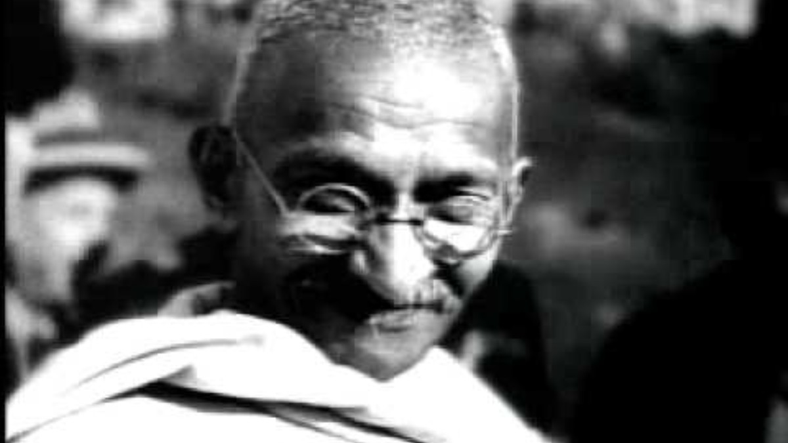
Notes:
Albert Einstein: Physicist, developed the theory of relativity, revolutionized our understanding of space, time, gravity, and the universe. Nobel Prize winner.
Bob Dylan: Singer-songwriter, poet. One of the most influential musicians of the 20th century, tackled social justice and philosophical themes in his music.
Martin Luther King Jr.: Civil rights leader, minister, champion of nonviolent resistance against racial segregation. Nobel Peace Prize winner.
Richard Branson: Entrepreneur, founder of the Virgin Group, known for his adventurous spirit and various business ventures.
John Lennon (with Yoko Ono): Musician, songwriter, peace activist. Co-founder of The Beatles, later explored solo career and activism with his wife Yoko Ono.
Buckminster Fuller: Architect, futurist, inventor. Known for the geodesic dome design and his systems thinking approach.
Thomas Edison: Inventor, businessman. Developed many devices including the lightbulb, phonograph, and motion picture camera.
Muhammad Ali: Boxer, activist. Heavyweight champion, known for his skill, showmanship, and activism on civil rights.
Mahatma Gandhi: Leader of Indian independence movement against British rule. Espoused nonviolent civil disobedience.
Amelia Earhart: Aviator. First female pilot to fly solo across the Atlantic Ocean.
Alfred Hitchcock: Filmmaker. Master of suspense, pioneered many techniques in thrillers and psychological dramas.
Maria Callas: Opera singer. One of the most renowned and influential opera singers of the 20th century.
Pablo Picasso: Artist. Co-founder of Cubism, hugely influential on 20th century art with groundbreaking styles.
Jim Henson (with Kermit the Frog): Puppeteer, filmmaker. Creator of The Muppets and iconic characters like Kermit, Miss Piggy, and Big Bird.
Frank Lloyd Wright: Architect and designer. Pioneer of modern organic architecture, with a focus on harmony between structures and their environment.

Slide 4
Plan for today
Albert Einstein: Physicist, developed the theory of relativity, revolutionized our understanding of space, time, gravity, and the universe. Nobel Prize winner.
Bob Dylan: Singer-songwriter, poet. One of the most influential musicians of the 20th century, tackled social justice and philosophical themes in his music.
Martin Luther King Jr.: Civil rights leader, minister, champion of nonviolent resistance against racial segregation. Nobel Peace Prize winner.
Richard Branson: Entrepreneur, founder of the Virgin Group, known for his adventurous spirit and various business ventures.
John Lennon (with Yoko Ono): Musician, songwriter, peace activist. Co-founder of The Beatles, later explored solo career and activism with his wife Yoko Ono.
Buckminster Fuller: Architect, futurist, inventor. Known for the geodesic dome design and his systems thinking approach.
Thomas Edison: Inventor, businessman. Developed many devices including the lightbulb, phonograph, and motion picture camera.
Muhammad Ali: Boxer, activist. Heavyweight champion, known for his skill, showmanship, and activism on civil rights.

Slide 5
Plan for today
Mahatma Gandhi: Leader of Indian independence movement against British rule. Espoused nonviolent civil disobedience.
Amelia Earhart: Aviator. First female pilot to fly solo across the Atlantic Ocean.
Alfred Hitchcock: Filmmaker. Master of suspense, pioneered many techniques in thrillers and psychological dramas.
Maria Callas: Opera singer. One of the most renowned and influential opera singers of the 20th century.
Pablo Picasso: Artist. Co-founder of Cubism, hugely influential on 20th century art with groundbreaking styles.
Jim Henson (with Kermit the Frog): Puppeteer, filmmaker. Creator of The Muppets and iconic characters like Kermit, Miss Piggy, and Big Bird.
Frank Lloyd Wright: Architect and designer. Pioneer of modern organic architecture, with a focus on harmony between structures and their environment.

Slide 6

Something to think about
"Piracy is almost always a service problem and not a pricing problem. For example, if a pirate offers a product purchasable from the convenience of your PC, and the legal provider says the product can only be purchased at a brick and mortar store, then the pirate's service is more valuable." - Gabe Newell, co-founder, Valve

Slide 7
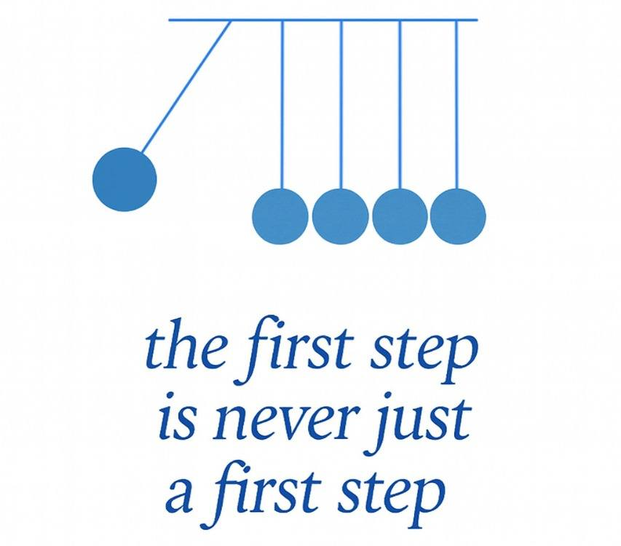

Slide 8

Plan for today
Schedule
Assignment
Entrepreneurship Theory and Practice
Types of Innovation
Idea Generation
Solution Generation
Lean Canvas Recap
Notes:
At the beginning of the lectures – will go over plan, and at end will make sure we covered what we planned for

Slide 9
 | Theme & Learning Outcomes | Assessments (%)
Week 1 Jan 14 | Intro to Entrepreneurship and Innovation | Journal 5%
Week 2 Jan 21 | Entrepreneurship, Emerging Tech, Economic Growth | Journal 5%
Week 3 Jan 28 | Types of Innovation, Problems and Solutions | Assignment 5%
Week 4 Feb 4 | Success Drivers in Tech Sector, Metrics | Quiz 5%
Week 5 Feb 11 | Stakeholders in Entrepreneurship and Innovation, Early Adopters | Journal 5%
Week 6 Feb 18 | Business Goals and Vision, Market Research and Marketing Strategies | Business/Project Idea 5%
Week 7 Feb 25 | Midterm Exam | Midterm Exam 20%
Week 8 | Study Break Week – NO CLASS

Slide 10
 | Theme & Learning Outcomes | Assessments (%)
Week 9 March 11 | Business Planning, Revenues, Costs | Group Contract 5%
Week 10 March 18 | Contract Negotiation
Week 11 March 25 | Budgeting and Finance in IT Projects | Business/Project Plan Part I 10%
Week 12 April 1 | Leadership and Organization Design | EI Assignment 5%
Week 13 April 8 | Developing a Technology-focused Business Plan | Business/Project Plan Part II 10% Demo and Plan Presentation 10%
Week 14 April 15 | Business Plan Presentations and Wrap-up | Self, Peer Evaluations 10%
Week 15 | Final Exam Week (NO EXAM)

Slide 11
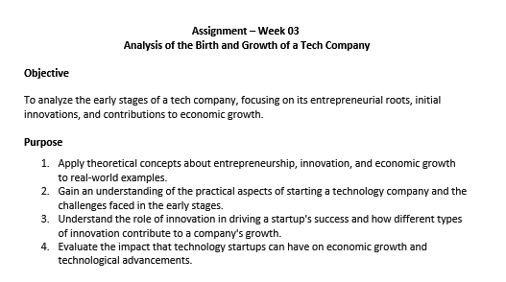
Assignment
Assignment
Due: Sunday, midnight
Use template on Brightspace assignment
Replace highlighted areas with your answers
Note minimum word count
Turnitin will be used for plagiarism
Watch How to know if you were meant to be an Entrepreneur
Notes:
Assignment

Slide 12


Slack Profile
Early Days (2009-2012):
2009: Slack begins as internal tool at Tiny Speck, a game development company founded by Stewart Butterfield, during the creation of the game Glitch.
2010: Tiny Speck raises significant funding from venture capital firms Accel Partners and Andreessen Horowitz.
2011: Glitch is launched but fails to gain traction.
2012: Tiny Speck shuts down Glitch, but the team recognizes the potential of Slack as a standalone product.

Slide 13
Slack Profile
Slack's Launch and Growth (2013-2018):
2013: Launched in beta, 8,000 users in the first 24 hours.
2014: Widespread adoption. Known for user-friendly UI & efficient team communication
2015: Daily active users increase rapidly. Receives significant investments, valuing the company at billions of dollars.
2016-2017: Competition heats up. Facebook and Microsoft launch their own collaboration tools. Slack continues to expand its enterprise offerings and secure major clients like IBM and 21st Century Fox.
2018:Slack surpasses 8 million daily active users.

Slide 14
Slack Profile
Going Public and Acquisition (2019-2021):
2019: June: Slack goes public through a direct listing on the New York Stock Exchange, reaching a market valuation of nearly $20 billion. Daily active users exceed 10 million.
2020: Salesforce announces its acquisition of Slack for a staggering $27.7 billion.

Slide 15
Slack Success
Problem-Solving: Slack identified the pain point of inefficient email communication and created a solution that resonates with businesses.
User Experience: Prioritizing a clean, intuitive interface contributed to widespread adoption.
Growth Strategy: Freemium model (free basic plan, paid upgrades) allowed users to try the platform and upgrade as their needs grew.
Adaptability: Integrations and customizability make it versatile and relevant across different industries.
Acquisition: Demonstrates the potential for successful startups to be acquired by larger companies.

Slide 16
Slack Success
Slack's success story highlights the importance of recognizing opportunity even in the face of failure (pivoting from Glitch to Slack).
User experience and effective communication crucial in driving Slack's rapid adoption.
Slack's journey demonstrates dynamic nature of tech industry, with constant competition and the potential for large acquisitions.
$27.7B X 8.6% = $2.4B

Slide 17

Something to think about
"You actually have to care about what you're doing. The business has to be about something. Whatever the point of it is does not have to be inconsistent with making money, but usually if that's the sole reason, it is not very successful." - Stewart Butterfield, Founder, Slack

Slide 18
Types of Innovation

Slide 19

Types of Innovation
1. Incremental Innovation
2. Radical Innovation
3. Disruptive Innovation
4. Architectural Innovation
Notes:
1. Incremental Innovation:
Incremental innovation involves making small scale improvements or updates to existing products, services, or processes. This is the most common type of innovation as it requires fewer resources and involves less risk. It can lead to better efficiency, productivity, and profitability, even though the improvements may seem minor on the surface.
2. Radical Innovation:
Radical innovation involves creating new concepts, products, or services that can drastically change existing markets or create entirely new ones. This type of innovation is more risky and requires significant resources but can lead to groundbreaking advancements and competitive advantages. Examples include the invention of the internet or the smartphone.
3. Disruptive Innovation:
Coined by Clayton Christensen, disruptive innovation describes a process by which a product or service takes root initially in simple applications at the bottom of a market and then relentlessly moves up market, eventually displishing established competitors. These innovations are not necessarily technologically superior to existing market offerings, but they transform existing markets or create new ones through their business model or route to market. An example is how Uber disrupted the traditional taxi industry.
4. Architectural Innovation:
Architectural innovation refers to changing the way that established technologies or processes are organized or integrated without changing the underlying technology. This type of innovation can lead to significant improvements in performance or functionality. An example might be changing the layout of a production line to improve efficiency.
5. Process Innovation:
Process innovation involves improving the processes used to manufacture goods or deliver services. This can involve changes in equipment, software, procedures, or performance metrics. Examples include implementing a new supply chain management system or adopting lean manufacturing techniques.
6. Product Innovation:
Product innovation involves creating new or improved goods or services. This can be a completely new product or changes to an existing product, like adding new features or improving its design. Examples include a new model of a car or a new type of smartphone.
7. Service Innovation:
Service innovation involves creating new or improved services. This can include changes in the service delivery process, the service concept, or the client interface. An example might be a bank offering online banking services.
8. Business Model Innovation:
Business model innovation involves changing the way a company creates, delivers, and captures value. This could include changes in a company's revenue model, cost structure, target customers, or distribution channels. Examples include the "freemium" model used by many software companies, or direct-to-consumer sales models.

Slide 20
Types of Innovation
5. Process Innovation
6. Product Innovation
7. Service Innovation
8. Business Model Innovation
Notes:
1. Incremental Innovation:
Incremental innovation involves making small scale improvements or updates to existing products, services, or processes. This is the most common type of innovation as it requires fewer resources and involves less risk. It can lead to better efficiency, productivity, and profitability, even though the improvements may seem minor on the surface.
2. Radical Innovation:
Radical innovation involves creating new concepts, products, or services that can drastically change existing markets or create entirely new ones. This type of innovation is more risky and requires significant resources but can lead to groundbreaking advancements and competitive advantages. Examples include the invention of the internet or the smartphone.
3. Disruptive Innovation:
Coined by Clayton Christensen, disruptive innovation describes a process by which a product or service takes root initially in simple applications at the bottom of a market and then relentlessly moves up market, eventually displishing established competitors. These innovations are not necessarily technologically superior to existing market offerings, but they transform existing markets or create new ones through their business model or route to market. An example is how Uber disrupted the traditional taxi industry.
4. Architectural Innovation:
Architectural innovation refers to changing the way that established technologies or processes are organized or integrated without changing the underlying technology. This type of innovation can lead to significant improvements in performance or functionality. An example might be changing the layout of a production line to improve efficiency.
5. Process Innovation:
Process innovation involves improving the processes used to manufacture goods or deliver services. This can involve changes in equipment, software, procedures, or performance metrics. Examples include implementing a new supply chain management system or adopting lean manufacturing techniques.
6. Product Innovation:
Product innovation involves creating new or improved goods or services. This can be a completely new product or changes to an existing product, like adding new features or improving its design. Examples include a new model of a car or a new type of smartphone.
7. Service Innovation:
Service innovation involves creating new or improved services. This can include changes in the service delivery process, the service concept, or the client interface. An example might be a bank offering online banking services.
8. Business Model Innovation:
Business model innovation involves changing the way a company creates, delivers, and captures value. This could include changes in a company's revenue model, cost structure, target customers, or distribution channels. Examples include the "freemium" model used by many software companies, or direct-to-consumer sales models.

Slide 21
Discussion
Think of a recent innovation. What type of innovation is/was it?
1. Incremental Innovation
2. Radical Innovation
3. Disruptive Innovation
4. Architectural Innovation
5. Process Innovation
6. Product Innovation
7. Service Innovation
8. Business Model Innovation
Notes:
1. Incremental Innovation:
Incremental innovation involves making small scale improvements or updates to existing products, services, or processes. This is the most common type of innovation as it requires fewer resources and involves less risk. It can lead to better efficiency, productivity, and profitability, even though the improvements may seem minor on the surface.
2. Radical Innovation:
Radical innovation involves creating new concepts, products, or services that can drastically change existing markets or create entirely new ones. This type of innovation is more risky and requires significant resources but can lead to groundbreaking advancements and competitive advantages. Examples include the invention of the internet or the smartphone.
3. Disruptive Innovation:
Coined by Clayton Christensen, disruptive innovation describes a process by which a product or service takes root initially in simple applications at the bottom of a market and then relentlessly moves up market, eventually displishing established competitors. These innovations are not necessarily technologically superior to existing market offerings, but they transform existing markets or create new ones through their business model or route to market. An example is how Uber disrupted the traditional taxi industry.
4. Architectural Innovation:
Architectural innovation refers to changing the way that established technologies or processes are organized or integrated without changing the underlying technology. This type of innovation can lead to significant improvements in performance or functionality. An example might be changing the layout of a production line to improve efficiency.
5. Process Innovation:
Process innovation involves improving the processes used to manufacture goods or deliver services. This can involve changes in equipment, software, procedures, or performance metrics. Examples include implementing a new supply chain management system or adopting lean manufacturing techniques.
6. Product Innovation:
Product innovation involves creating new or improved goods or services. This can be a completely new product or changes to an existing product, like adding new features or improving its design. Examples include a new model of a car or a new type of smartphone.
7. Service Innovation:
Service innovation involves creating new or improved services. This can include changes in the service delivery process, the service concept, or the client interface. An example might be a bank offering online banking services.
8. Business Model Innovation:
Business model innovation involves changing the way a company creates, delivers, and captures value. This could include changes in a company's revenue model, cost structure, target customers, or distribution channels. Examples include the "freemium" model used by many software companies, or direct-to-consumer sales models.

Slide 22
Idea Generation

Slide 23

Idea Generation
1. Identify Your Passion 2. Find a Problem to Solve 3. Market Research 4. Brainstorm 5. Seek Inspiration from Others
Notes:
1. Identify Your Passion: Start with what you know and love. An enterprise built around your passion is likely to have a greater chance of success.
2. Find a Problem to Solve: Effective business ideas often solve a problem. Look for problems in your own life or other people's lives, and think about how you can solve them.
3. Market Research: Look for trends and gaps in the market. What are customers asking for that's not being met? What are the emerging trends that could present opportunities?
4. Brainstorm: Let your mind run wild and jot down as many ideas as you can think of. Then, refine these ideas based on feasibility, your personal interest, and market demand.
5. Seek Inspiration from Others: Look at successful businesses, especially those outside your chosen field. They can stimulate your thinking and provide inspiration.
6. Network: Interact with a diverse range of people. Networking can provide new perspectives and stimulate creative thinking. You never know where a casual conversation may lead.
7. Evaluate Existing Products and Services: Look at current products and services and think about how they could be improved.
8. Think About The Future: What does the future look like in your area of interest? Can you predict any needs that will arise?
9. Prototype and Get Feedback: If you have an idea, create a basic prototype or outline of the business concept. Share it with trusted friends, mentors, and potential customers to get feedback.
10. Keep an Ideas Journal: Inspiration can strike at any time. Keep a journal to jot down ideas as they come, and review it regularly to stimulate new thoughts.

Slide 24
Idea Generation
6. Network 7. Evaluate Existing Products and Services 8. Think About The Future 9. Prototype and Get Feedback 10. Keep an Ideas Journal 11. OTHERS?
Notes:
1. Identify Your Passion: Start with what you know and love. An enterprise built around your passion is likely to have a greater chance of success.
2. Find a Problem to Solve: Effective business ideas often solve a problem. Look for problems in your own life or other people's lives, and think about how you can solve them.
3. Market Research: Look for trends and gaps in the market. What are customers asking for that's not being met? What are the emerging trends that could present opportunities?
4. Brainstorm: Let your mind run wild and jot down as many ideas as you can think of. Then, refine these ideas based on feasibility, your personal interest, and market demand.
5. Seek Inspiration from Others: Look at successful businesses, especially those outside your chosen field. They can stimulate your thinking and provide inspiration.
6. Network: Interact with a diverse range of people. Networking can provide new perspectives and stimulate creative thinking. You never know where a casual conversation may lead.
7. Evaluate Existing Products and Services: Look at current products and services and think about how they could be improved.
8. Think About The Future: What does the future look like in your area of interest? Can you predict any needs that will arise?
9. Prototype and Get Feedback: If you have an idea, create a basic prototype or outline of the business concept. Share it with trusted friends, mentors, and potential customers to get feedback.
10. Keep an Ideas Journal: Inspiration can strike at any time. Keep a journal to jot down ideas as they come, and review it regularly to stimulate new thoughts.

Slide 25
Solution Generation

Slide 26
Solution Generation
Class discussion: Once you have identified the problem to solve, what are some techniques for finding solutions?

Slide 27
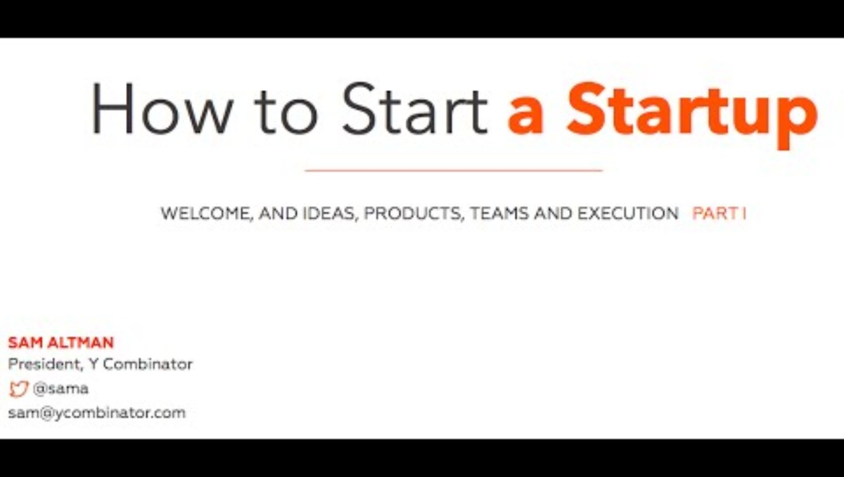
https://www.youtube.com/watch?v=CBYhVcO4WgI

Slide 28
Lean Canvas Recap

Slide 29
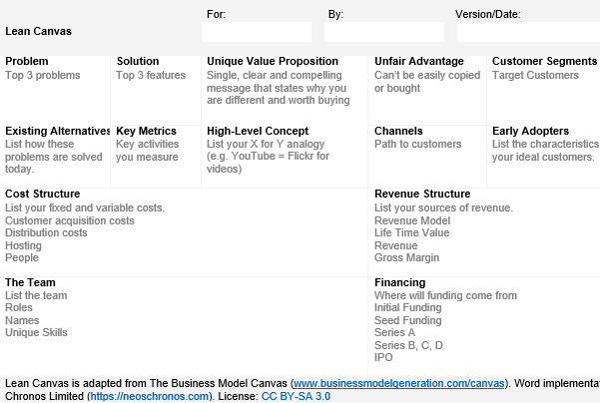
Intro to the Lean Canvas
The Lean Canvas visually presents the core assumptions for the main elements of a business:
Problem
Solution
Unique Value Proposition
Unfair Advantage
Customer Segments
Existing Alternatives
Key Metrics
High Level Concept
Channels
Early Adopters
Cost Structure
Revenue Structure
The Team
Financing

Slide 30

Lean Canvas – 1. Problem
If there’s no problem — there’s no business idea to solve it, simple as that.
Clearly describe the problem you are trying to solve.
One way: Toyota’s Why X 5 Analysis

Slide 31

Lean Canvas – 1. Problem
Example Scoob-e, an e-bike renting app in Vienna. Start with Why?
It’s hard to move around in Vienna. But if we continue using the ‘Why?’ technique we might get to the following problems:
There are traffic jams if you use a car. People don’t want to stay in traffic jams.
It’s not easy to park your car in the city center. Finding a parking spot is a nuisance.
Public transport picks you up at certain spots, at certain times. Who wants to wait?
Most cars aren’t eco-friendly.
In the end, you’ll get the core problems that your prospects face.

Slide 32

Lean Canvas – 2. Solution
Review the Problems box. What is your solution to the problem?
Need ideas/clarifications/refining?
Share your Lean Canvas Problems and drafts with colleagues
Interview your target audience and find out their take
Research on Web

Slide 33

Lean Canvas – 3. Unique Value Proposition
Establish a clear understanding of who your product is for and why users should choose your company instead of your competitors.
The word ‘unique’ is here for a reason. Your value proposition needs to stand out. There are so many companies on the market, you either get noticed or go home. There are three components to your UVP:
Who is this product for?
What is the clear benefit?
Why should they choose you instead of the others?

Slide 34
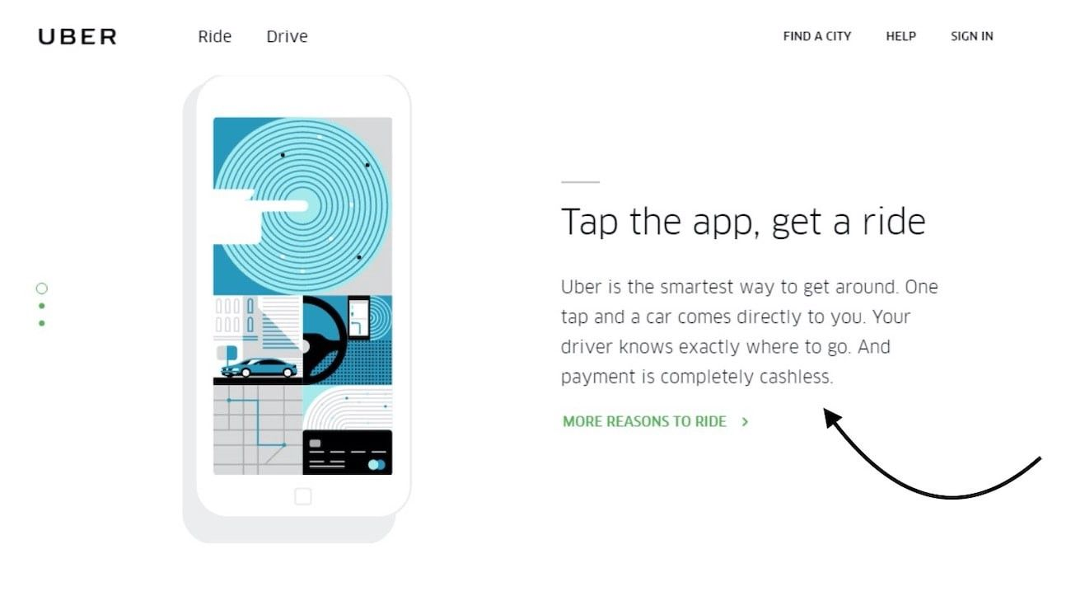
Lean Canvas – 3. Unique Value Proposition

Slide 35
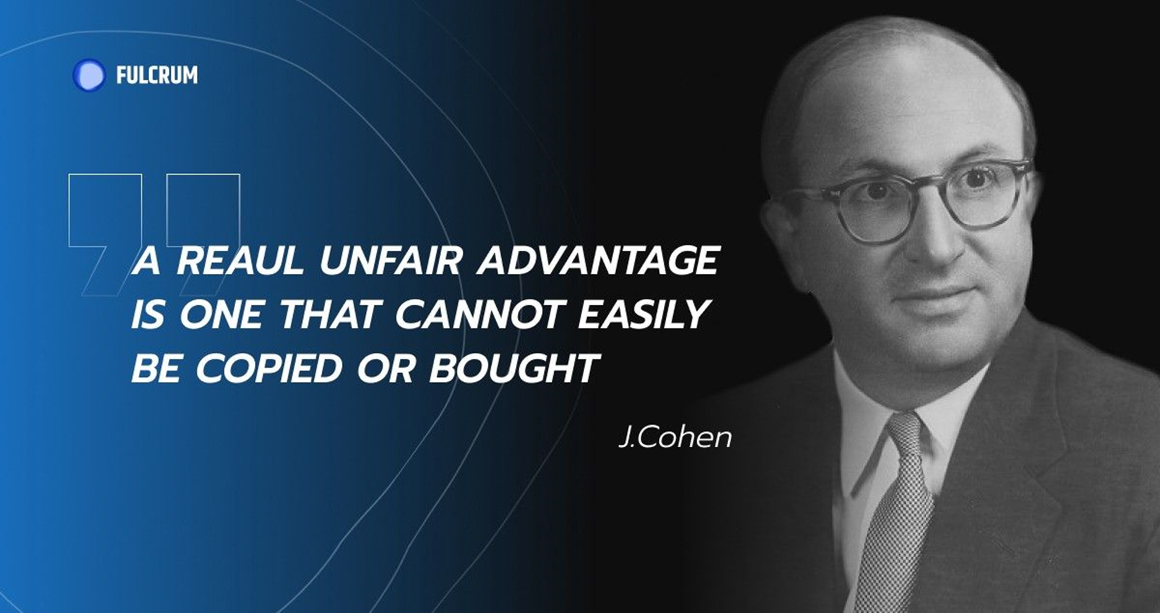
Lean Canvas – 4. Unfair Advantage
What aspects of your solution, team, or approach give you an unfair advantage?
Fantastic experts on your team?
Cutting Edge Technologies?
Access to a market?
First-hand information about a disruption?
New idea to improve on an existing one?

Slide 36
Assignment
Assignment
Due: Sunday, midnight
Use template on Brightspace assignment
Replace highlighted areas with your answers
Note minimum word count
Turnitin will be used for plagiarism and AI detection
Watch How to know if you were meant to be an Entrepreneur
Notes:
Assignment

Slide 37
Plan for today
Schedule
Assignment
Entrepreneurship Theory and Practice
Types of Innovation
Idea Generation
Solution Generation
Lean Canvas Recap
Notes:
At the beginning of the lectures – will go over plan, and at end will make sure we covered what we planned for

